Slide 1
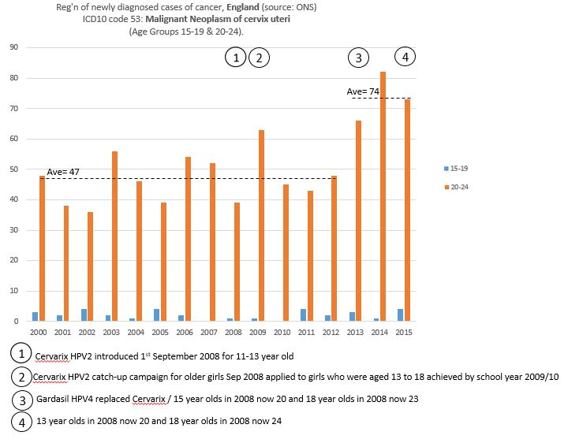
England
By 2013 many young women in the 20-24 age group should have been protected by the HPV vaccine!
But the registration of newly diagnosed cases or cervical cancer are increasing!

Slide 2
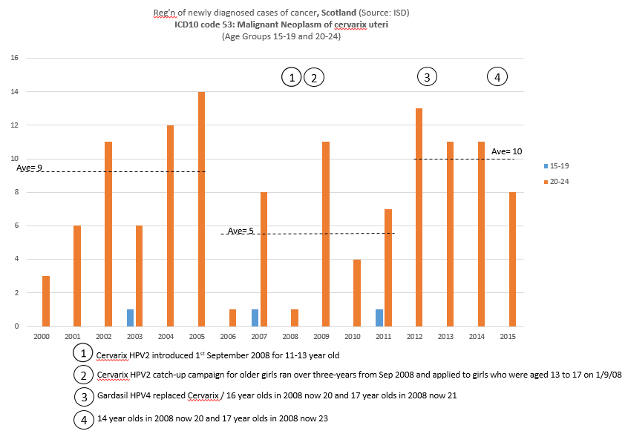
Scotland
By 2013 many young women in the 20-24 age group should have been protected by the HPV vaccine!
But the registration of newly diagnosed cases or cervical cancer are increasing with twice as many cases as in the 6 year period prior to the HPV vaccine introduction!

Slide 3
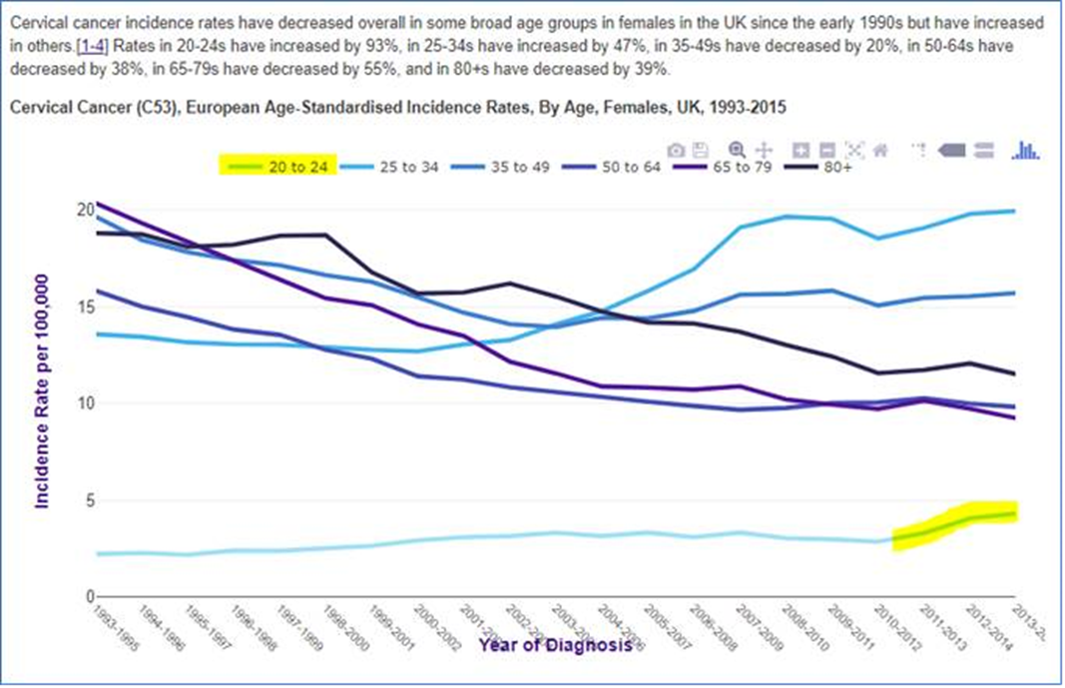
http://www.cancerresearchuk.org/health-professional/cancer-statistics/statistics-by-cancer-type/cervical-cancer/incidence#heading-Two

Slide 4
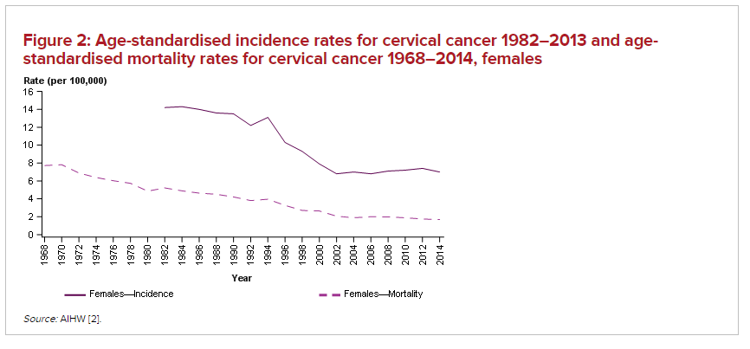
Australia cervical cancer rates: https://cervical-cancer.canceraustralia.gov.au/statistics
National HPV Vaccination Program introduced

Slide 5
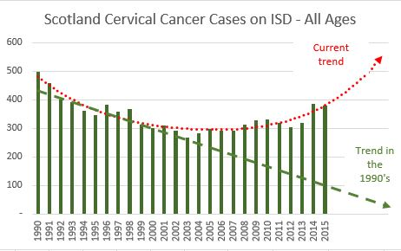
AHVID has written to the Scotland Chief Medical Officer requesting an explanation for this alarming trend.
In the 1990’s the improvement was attributable to an increase in Pap screening but the screening rates have reduced in recent years as the government has focused priority on HPV vaccination!

Slide 6
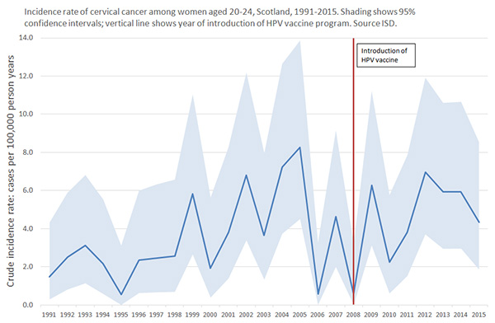
http://www.isdscotland.org/Health-Topics/Cancer/Cervical-Screening/
HPV vaccine and cervical cancer in Scotland
The figure below shows the number of new cases of cervical cancer per 100,000 women for those aged 20-24 in Scotland between 1991 and 2015. It addresses the question of whether the introduction of HPV vaccine in 2008 has so far made any difference to the risk of cervical cancer in this age group, which is expected to be among the first to benefit. However the number of cases of cervical cancer in this age group in Scotland (under 15 annually during this period) is too small to draw any reliable conclusions from the data so far. There is as yet no clear indication of any change in rates following introduction of the vaccine. The shaded area shows pointwise confidence intervals around crude rates, indicating the wide degree of uncertainty. Continuing monitoring of cervical cancer rates is important to assess the impact of the vaccine. Previously published information about rates of cervical dysplasia provides an earlier indication of the impact of HPV and suggests that rates of dysplasia may be falling. Cervical dysplasia is an important risk factor for cervical cancer and these declines provide some indication that cervical cancer rates are likely to fall in due course.

Slide 7
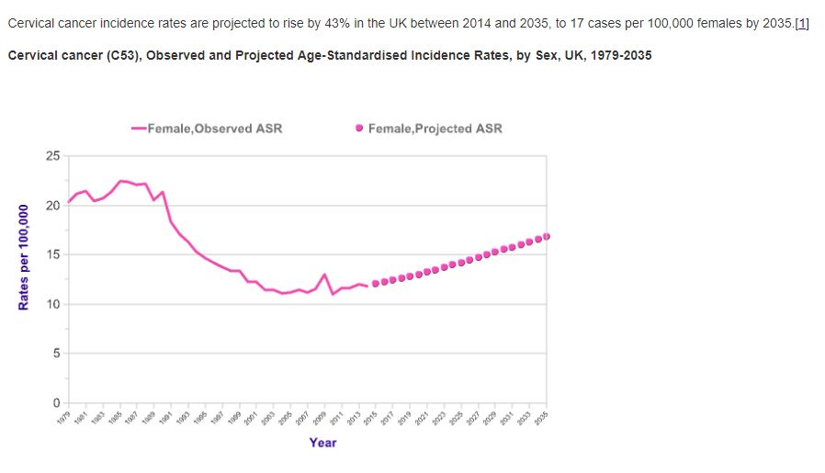
Cancer Research UK is a leading authority on cancers in the UK. It is forecasting a 43% rise in cervical cancer rates by 2035. WHY?
Source: http://www.cancerresearchuk.org/health-professional/cancer-statistics/statistics-by-cancer-type/cervical-cancer/incidence#heading-Five
AHVID has requested Cancer Research UK for an explanation of this alarming trend – without response.

Slide 8
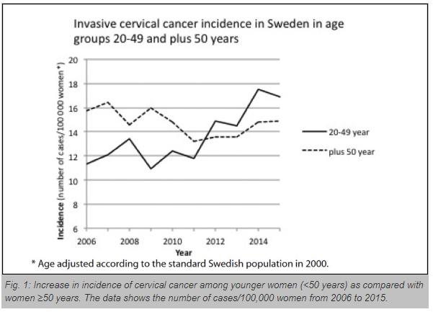
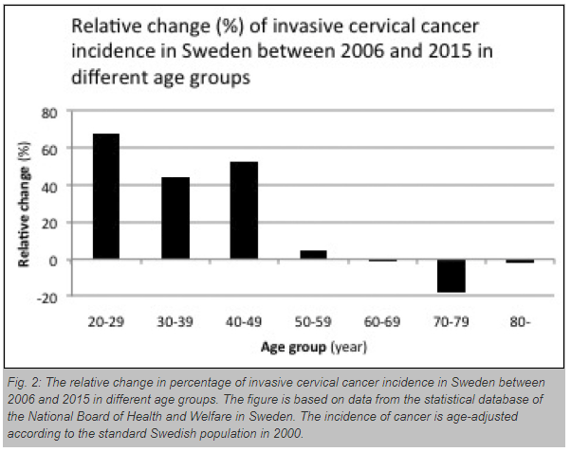
The Centre for Cervical Cancer Prevention in Sweden has noted in its annual report a substantial increase in the incidence of invasive cervical cancer
http://ijme.in/articles/increased-incidence-of-cervical-cancer-in-sweden-possible-link-with-hpv-vaccination/?galley=html

Slide 9
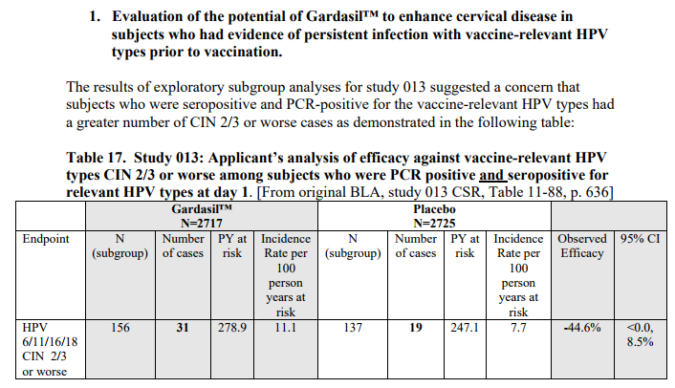
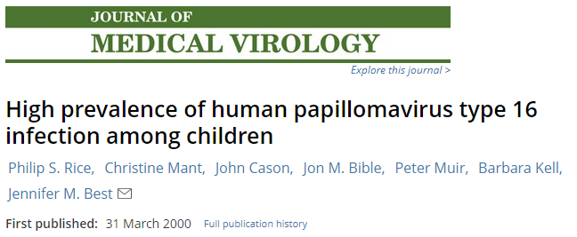
So what other reasons might there be for an increase in cervical cancers in the post vaccination era?
https://www.fda.gov/ohrms/dockets/ac/06/briefing/2006-4222B3.pdf
In 2006 the FDA reported a 44.6% increase in ‘CIN2/3 or worse’ in subjects who had evidence of HPV infection prior to vaccination (Study 013).
http://onlinelibrary.wiley.com/doi/10.1002/(SICI)1096-9071(200005)61:1%3C70::AID-JMV11%3E3.0.CO;2-Y/abstract
In 2000 a report by Rice (King's College London) indicated a ‘High prevalence of HPV type 16 infection amongst children’ aged 3-11 with 138 out of 267 testing positive (51.7%)
https://www.ncbi.nlm.nih.gov/pubmed/14556274
In 2003 Mant reported ‘HPV 16 is a common yet transitory event of childhood “most probably acquired from their peers.”

Slide 10
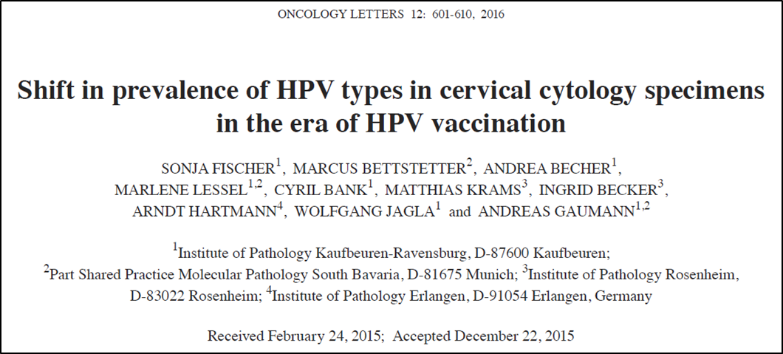
So what other reasons might there be for an increase in cervical cancers in the post vaccination era?
This study by Fischer in 2015 hypothesizes that there may be a continuous shift in the prevalence of HPV types as a result of vaccination.
Furthermore, the percentage of non‑vaccine High Risk HR‑HPV types was higher than expected, considering that eight HPV types formerly classified as ‘low‑risk’ or ‘probably high‑risk’ are in fact High Risk‑HPV types.

Slide 11
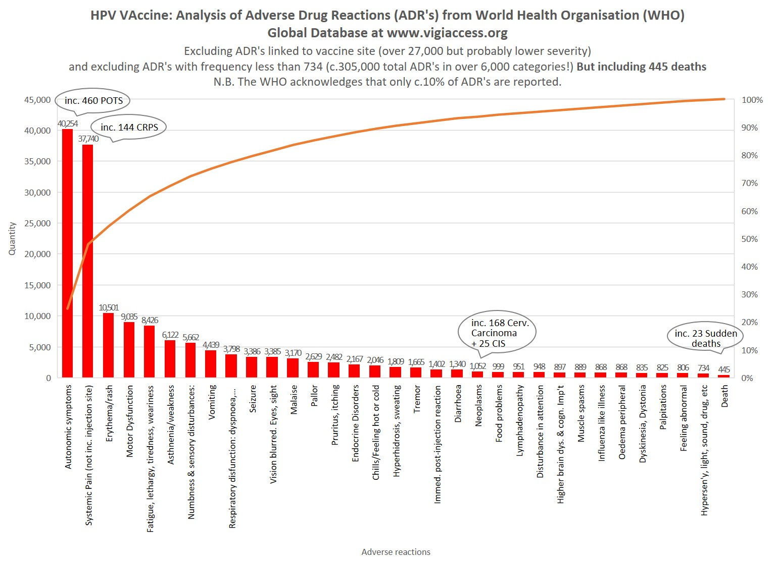
445 deaths (inc. 23 sudden deaths)
1,052 neoplasms (inc. 168 cervical carcinoma and 25 carcinoma insitu)
460 cases of POTS
144 cases of CRPS
305,014 adverse reactions in 81,263 reports.

